Slide 1

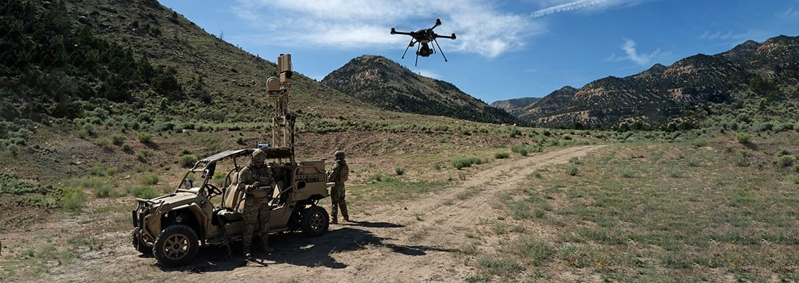
Autonomous Drones for Border Security
Heriot-Watt University Dubai
MSc. Robotics Presentation 2023-2024
Presented By: Yehia Gomaa – H00409854
Supervised by: Dr. Nidhal Abdulaziz
FLIR. Available at: https://www.flir.com/surveillance/border-surveillance/

Slide 2
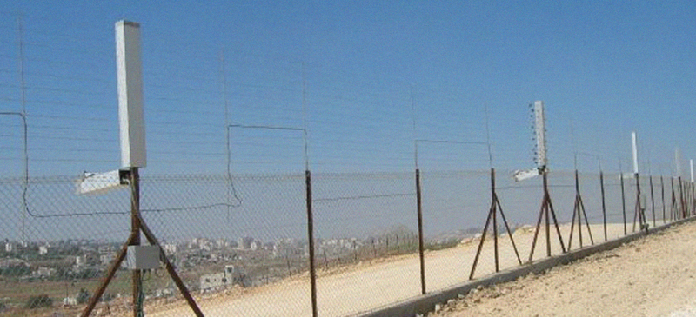
Introduction
Safeguarding national security and territorial integrity from illegal activities and cross-border threats is a matter of utmost importance
Traditional border patrolling methods such as physical barriers and human patrols have their limitations
Such as the high cost, potential human errors, and high risk for the human element.
Elbitsytems Border Protection. Available at: https://elbitsystems.com/product/border-security/

Slide 3
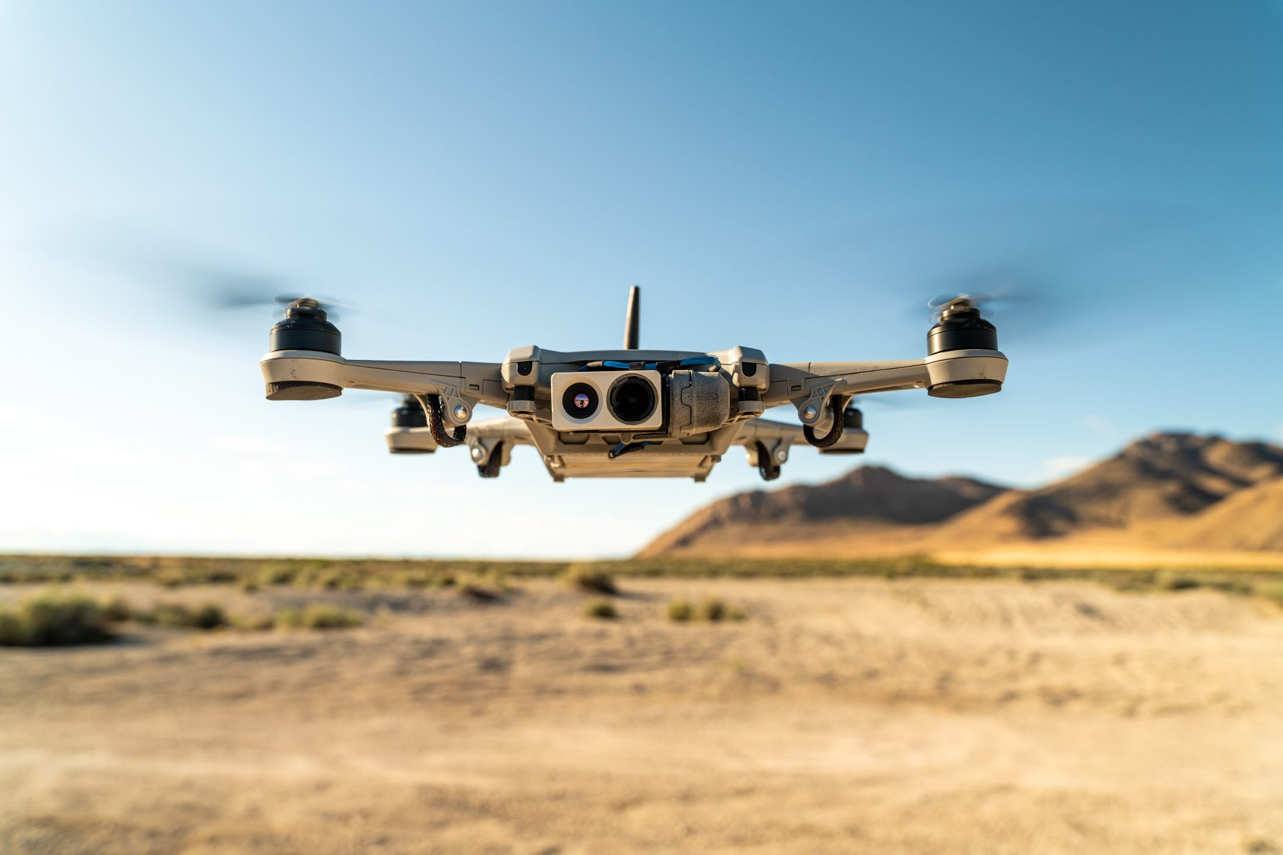
Introduction
Cost effective
Adopting autonomous drones for border surveillance has many potential benefits
Continuous operation
Reduces risk to the human element
Efficiently covering large areas with minimal human intervention
Gathering real-time data for informed decision-making.
Evans, S. (2022) IOT World Today. Available at: https://www.iotworldtoday.com/robotics/u-s-border-patrol-makes-1m-drone-purchase-.

Slide 4
Related Works
(Sharma et al., 2021) proposed the development of a system that detects and tracks border intruders using Passive Infrared Motion Detectors, Photoelectric Beams, Sound Sensors, and drones for tracking.
However, they offer no experimental findings to back up the proposal, they mention they had several problems with their drone.
(Vijayanandh et al., 2019) explore the theoretical use of solar powered UAVs for border surveillance. They use image processing techniques on MATLAB to build a border intrusion detection system.
Although environmentally friendly and sustainable, they fail to mention its drawbacks such as weather-related limitations which will affect its efficiency.

Slide 5
Objectives
Investigate the use of autonomous drones for border security
Develop an autonomous drone system capable of patrolling a predefined area.
Implement real-time object detection to identify potential intruders.
Add to the larger fields of autonomous robotics and national security
Comprehensive literature review on the use of autonomous drones for border security

Slide 6
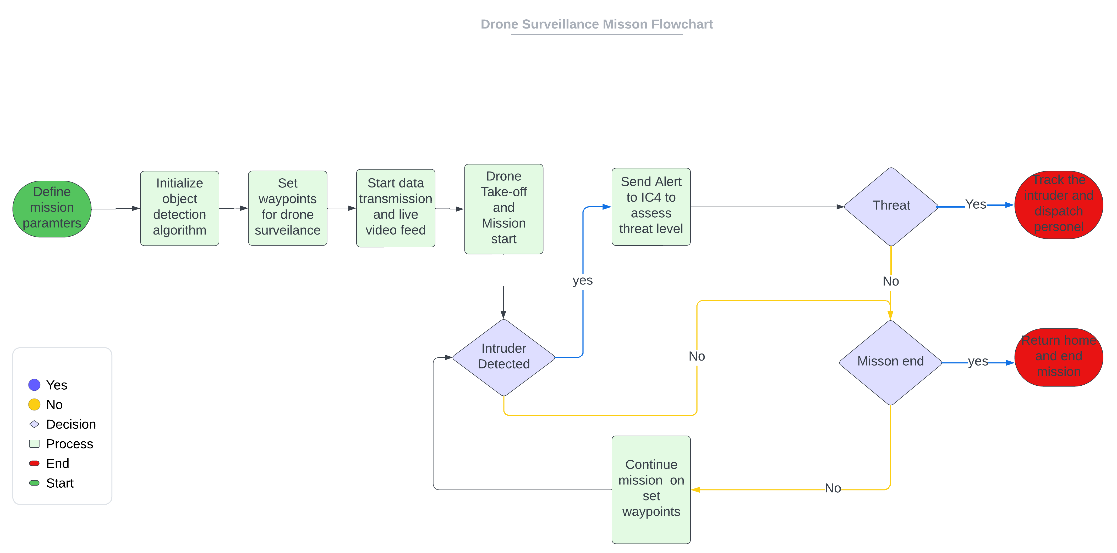
Drone Surveillance Mission Flowchart

Slide 7
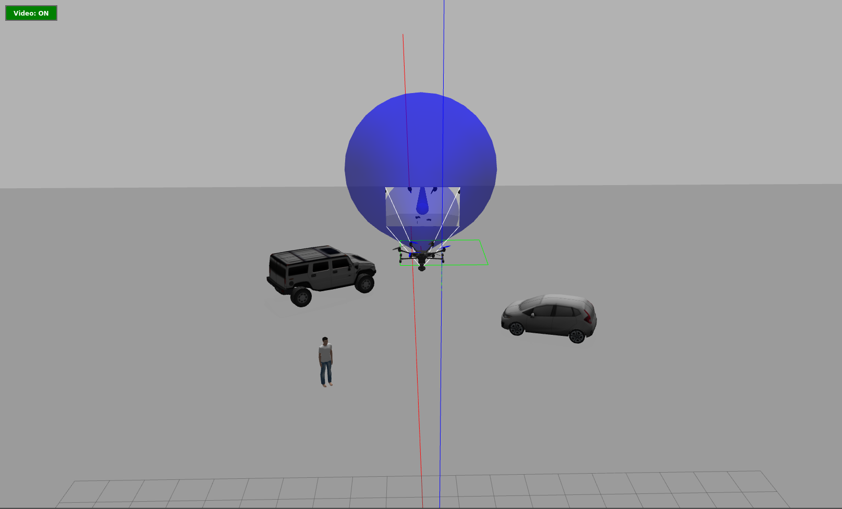
Simulation Environment
The Gazebo simulation software (Koenig and Howard, 2004) was used to create a virtual environment for the drone.
Lowering the cost and risk for physical testing.
The ability to recreate various scenarios.
Readily integrated with ROS for development.
Can be integrated with the PX4 SITL (Lorenz Meier, 2011) drone development tools.
Notes:
Typhoon H480 Hexcopter

Slide 8
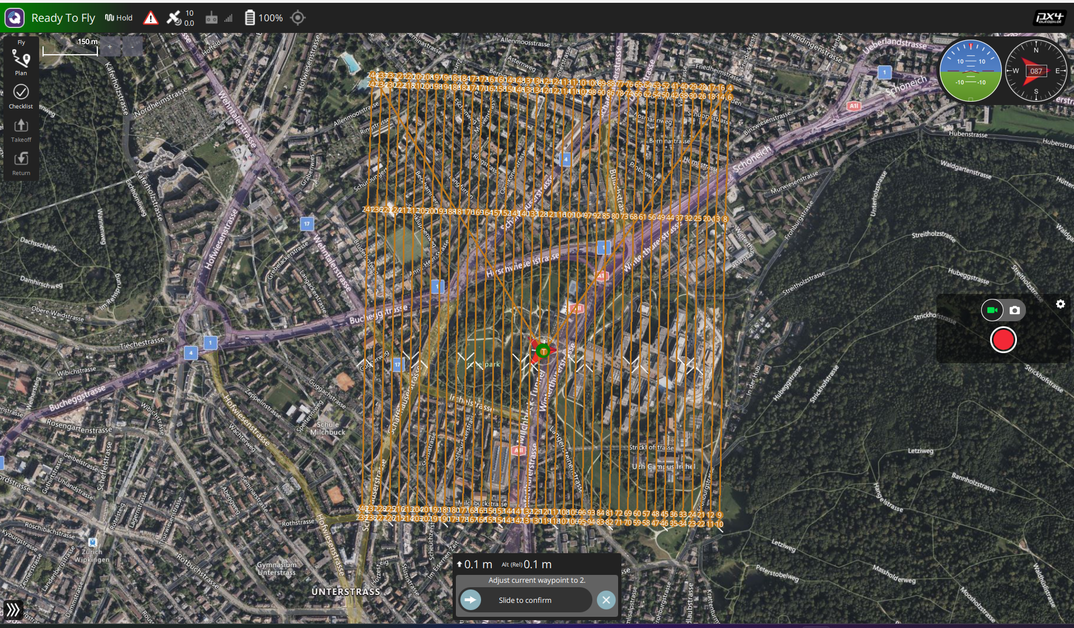
Misson Planning
QGroundControl software (Lorenz Meier, 2012) was used as ground control mission planner.
Integrated with ROS through MAVlink.
GUI easy to understand and interpret.
Set waypoints for surveillance area based upon the battery consumption.
Monitor the drone’s battery, heading, GPS coordinates altitude ,and speed.

Slide 9
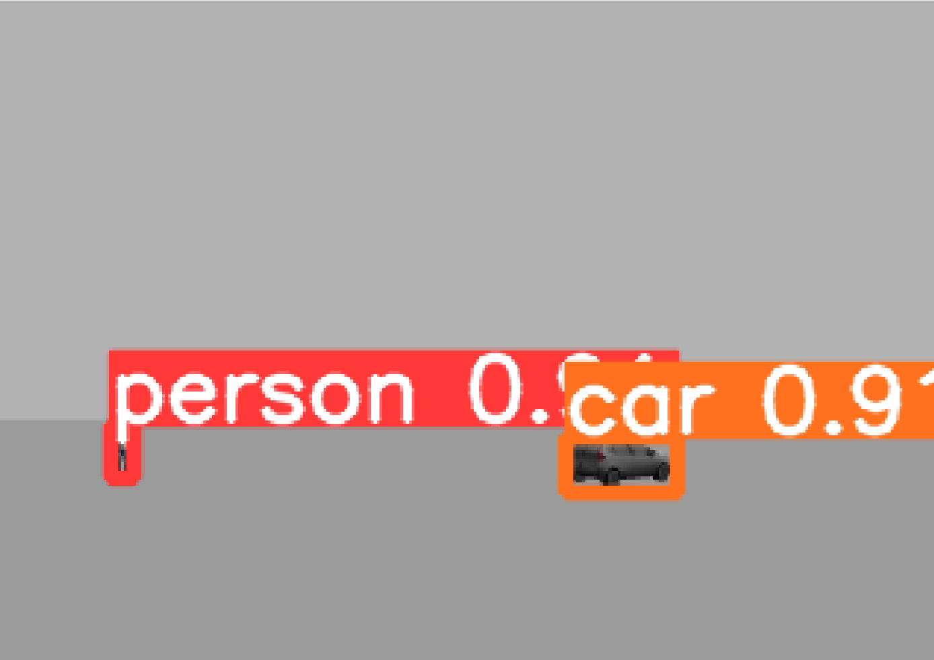
Object Detection
Object detection is the main component of this platform.
With real time performance and accuracy being the primary focus.
YOLOv5 (Ultralytics, 2020) was chosen as the object detection algorithm for these very reasons.
And it can be integrated with ROS.
Can run online onboard the drone as well as offline in the ground control
Notes:
Photo taken at 25m altitude; Object distance is 55m
single-shot object detection architecture.

Slide 10
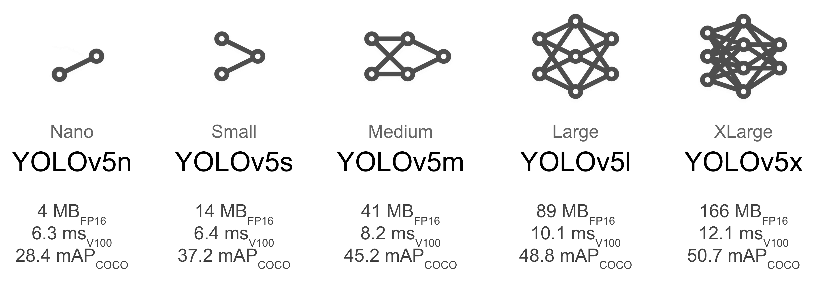
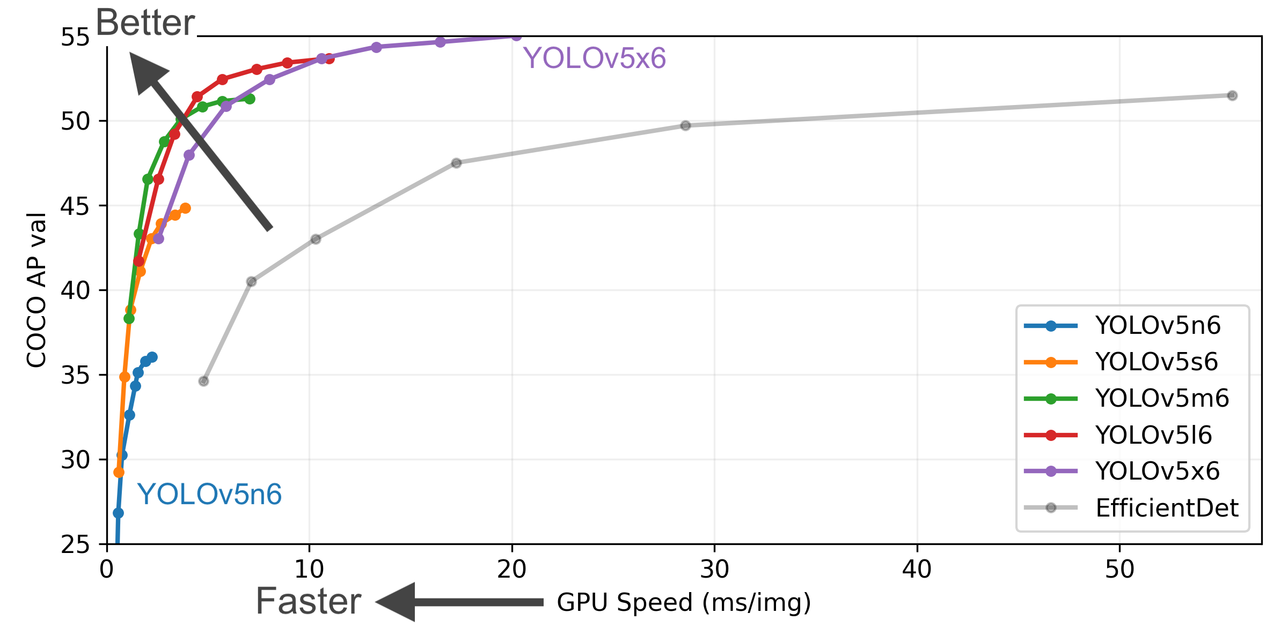
Object Detection
After different trials YOLOv5m model was chosen for training.
Training time is much lower compared to the large and Xlarge versions and the accuracy is higher than the nano and small versions.
The model also directly affects inference time. The larger the model the slower the inference.
Jocher, G. (2020) YOLOv5 by Ultralytics. Available at: https://github.com/ultralytics/yolov5.
Notes:
YOLOv5 employs a backbone network to extract features from the input image. The backbone network is a convolutional neural network (CNN, Darknet53.
YOLOv5 divides the image into a grid of cells. Each cell is responsible for predicting bounding boxes and class probabilities for the objects it contains

Slide 11
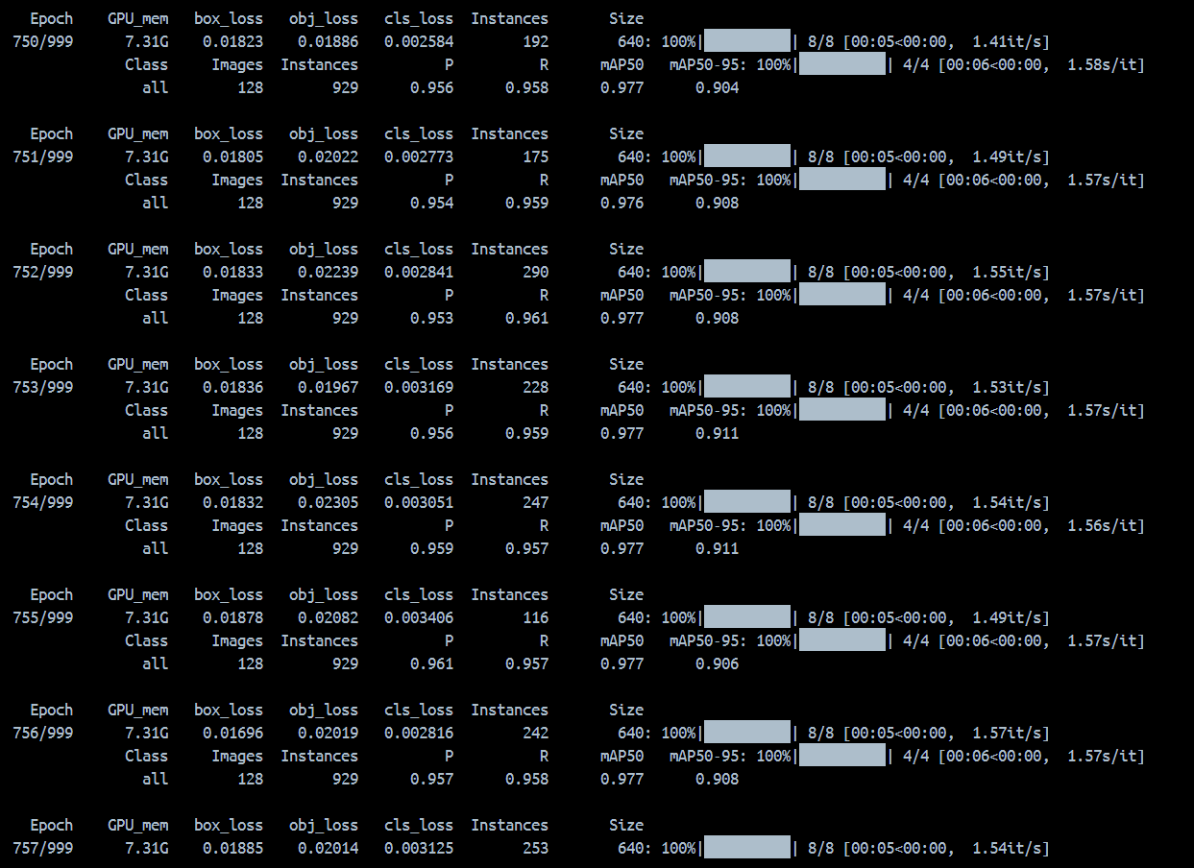
Object Detection
It was trained on the MS COCO128 dataset on 1000 epochs.
MS COCO128 is the first 128 images of the MSCOCO dataset (Lin et al., 2015) instead of the full 123,000. which allows for faster training.
Training took almost 6 hours to complete.
Notes:
MS COCO128 is the first 128 images of the MSCOCO dataset instead of the full 123,000. which allows for faster training.

Slide 12
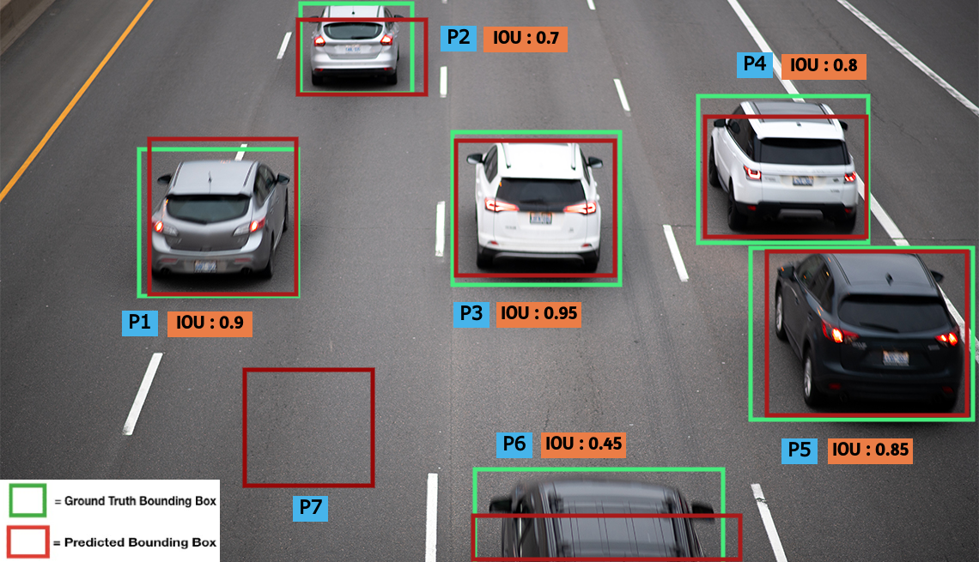
Results & Findings
Mean average precision (mAP) is the primary evaluation metric for object detection models
Precision = TP/TP+FP, Recall = TP/TP+FN
Average Precision AP is the area under the Precision/Recall curve
mAP is calculated based on the Intersection over union (IoU) threshold
MSCOCO uses 10 thresholds from 0.5 to 0.95 with 0.05 increments and takes their average [mAP@(0.5:0.95)]
V7labs, available at: https://www.v7labs.com/blog/mean-average-precision

Slide 13
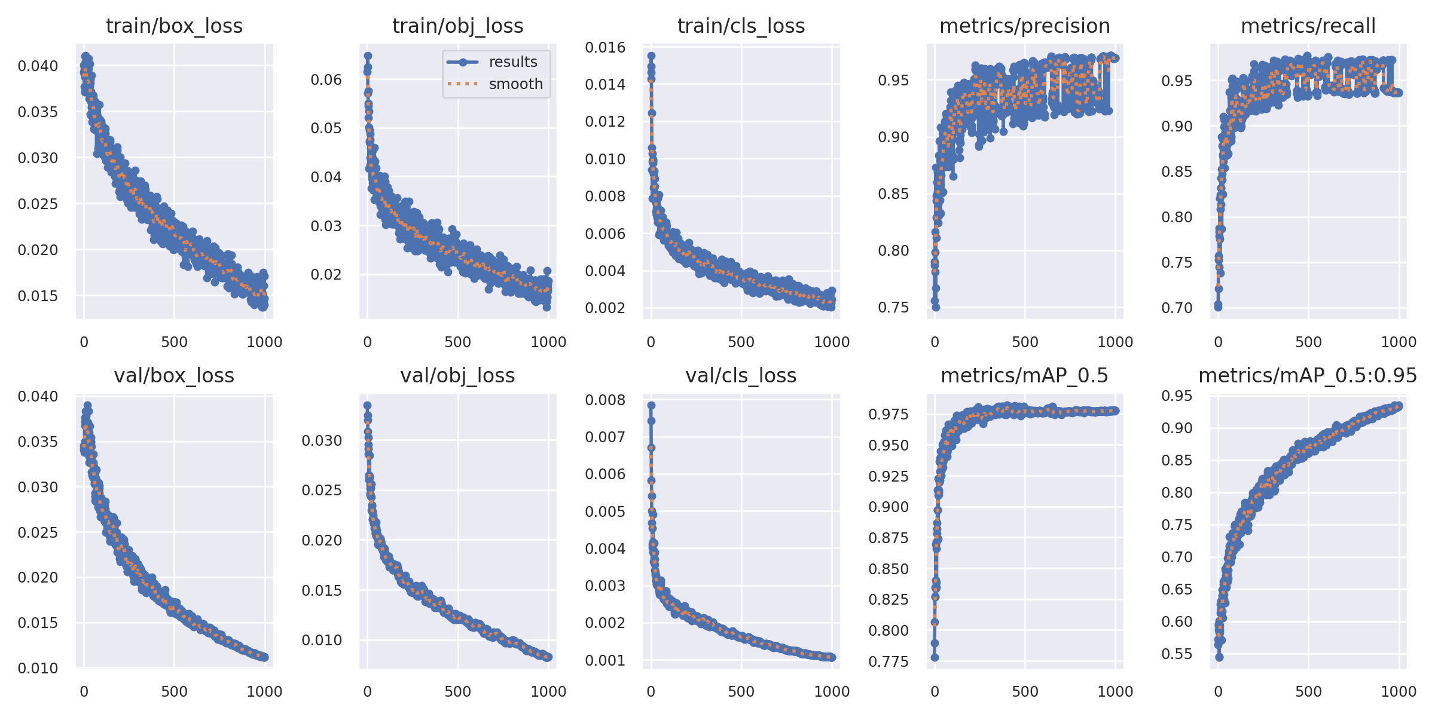
Results & Findings
train/Box loss: 0.015 – val/box loss: 0.012 - accuracy of bounding box predictions
Train/Obj loss: 0.02 – val/obj loss: 0.008 - measuring object confidence
Train/Class loss: 0.002 – val/cls loss: 0.001 - measuring class prediction accuracy
Notes:
train/Box loss: 0.015 – val/box loss: 0.012 ---- accuracy of bounding box predictions
Train/Obj loss: 0.02 – val/obj loss: 0.008 ----- measuring object confidence
Train/Class loss: 0.002 – val/cls loss: 0.001 ---- measuring class prediction accuracy

Slide 14
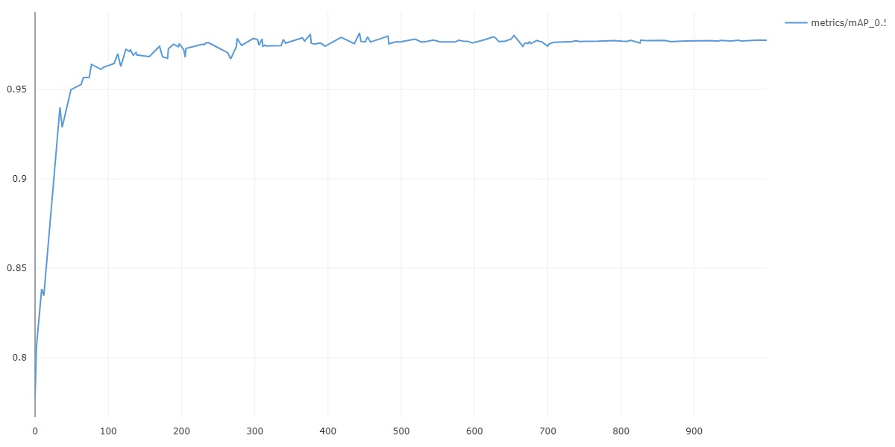
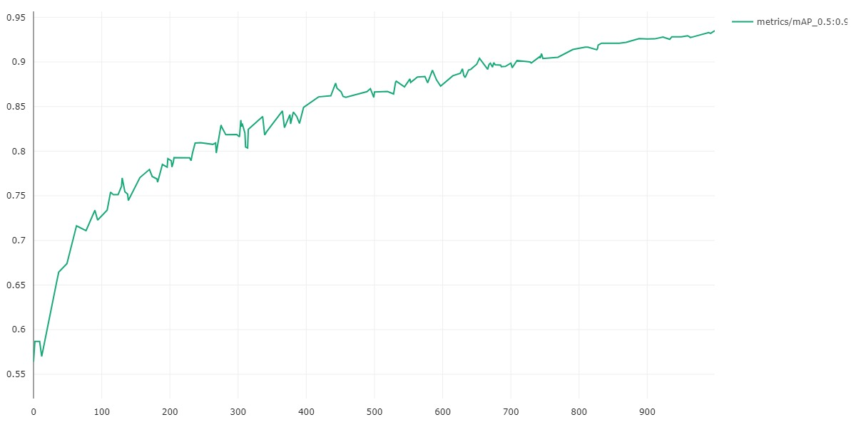
Results & Findings
Mean average precision (mAP) is the primary evaluation metric for object detection models
mAP is calculated based on the Intersection over union (IoU) threshold between the bounding box and the ground truth
MSCOCO uses 10 thresholds from 0.5 to 0.95 with 0.05 increments and takes their average [mAP@(0.5:0.95)]
mAP@[0.5:0.95] = 0.934
mAP@50 = 0.98
Notes:
train/Box loss: 0.015 – val/box loss: 0.012
Train/Obj loss: 0.02 – val/obj loss: 0.008
Train/Class loss: 0.002 – val/cls loss: 0.001

Slide 15
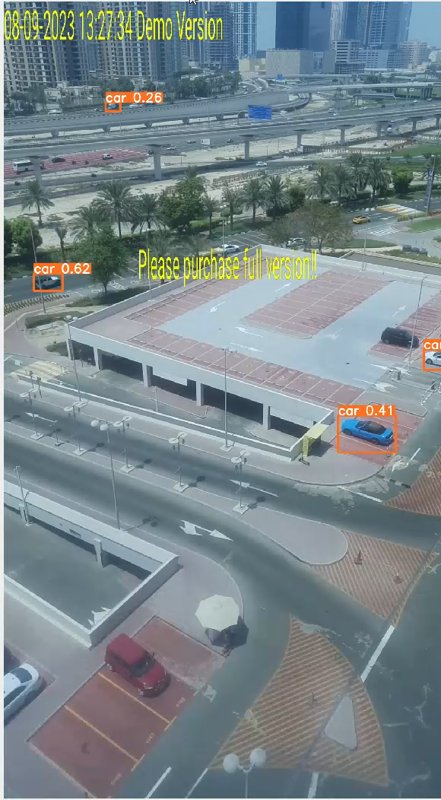
Results and Findings
Recommended flight altitude for detection is 50m, however recognition is at 30m, and (identification is 10m) using a normal HD camera.
A slanted camera 30◦ degrees provides better detection rather than top down.
Average detection time is 6.3ms
Notes:
Video taken at 8th floor (Roughly 50m)

Slide 16
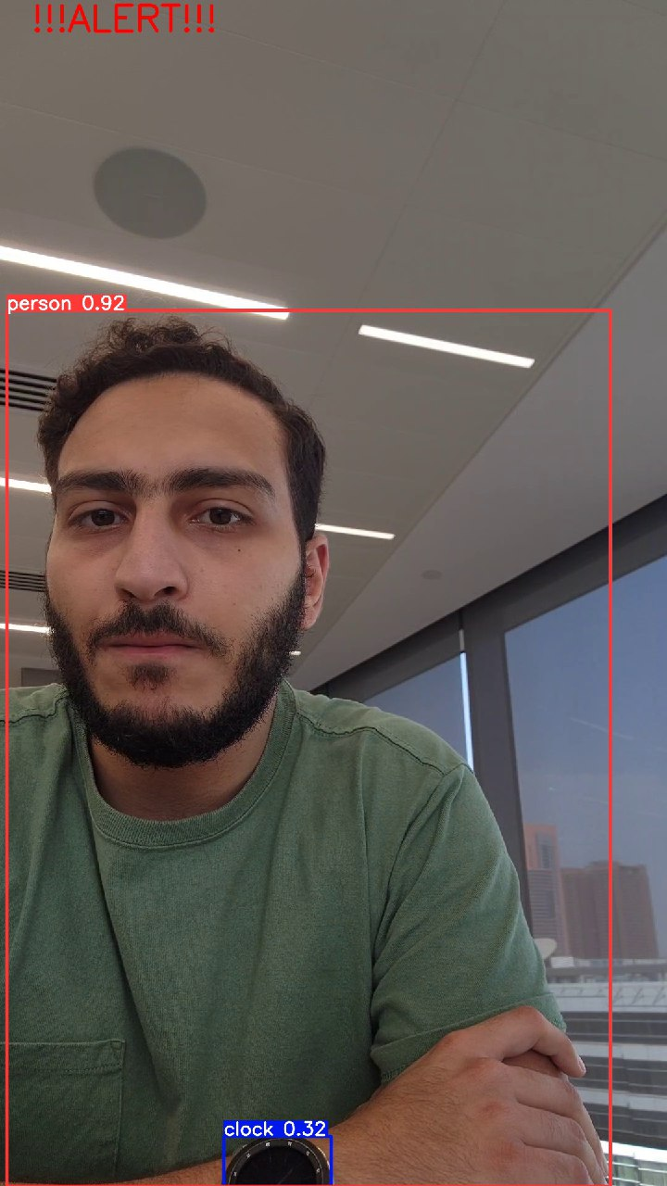
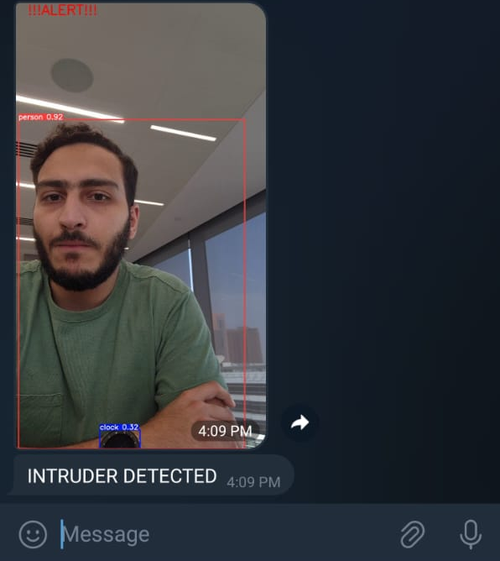
Results & Findings
The detection algorithm outputs the detected class.
If an intruder is detected. An alert will be sent out.
In the form of a visual alert on the screen.
And in the form of a message notification on a mobile device through a telegram bot.
Notes:
Real time stream from the phone’s camera

Slide 17
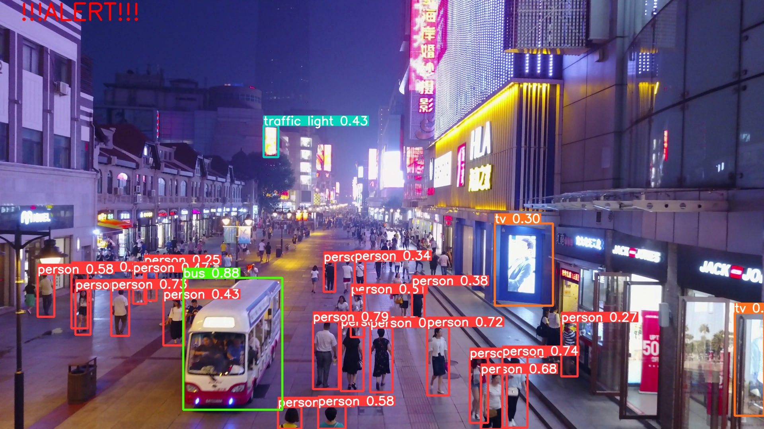
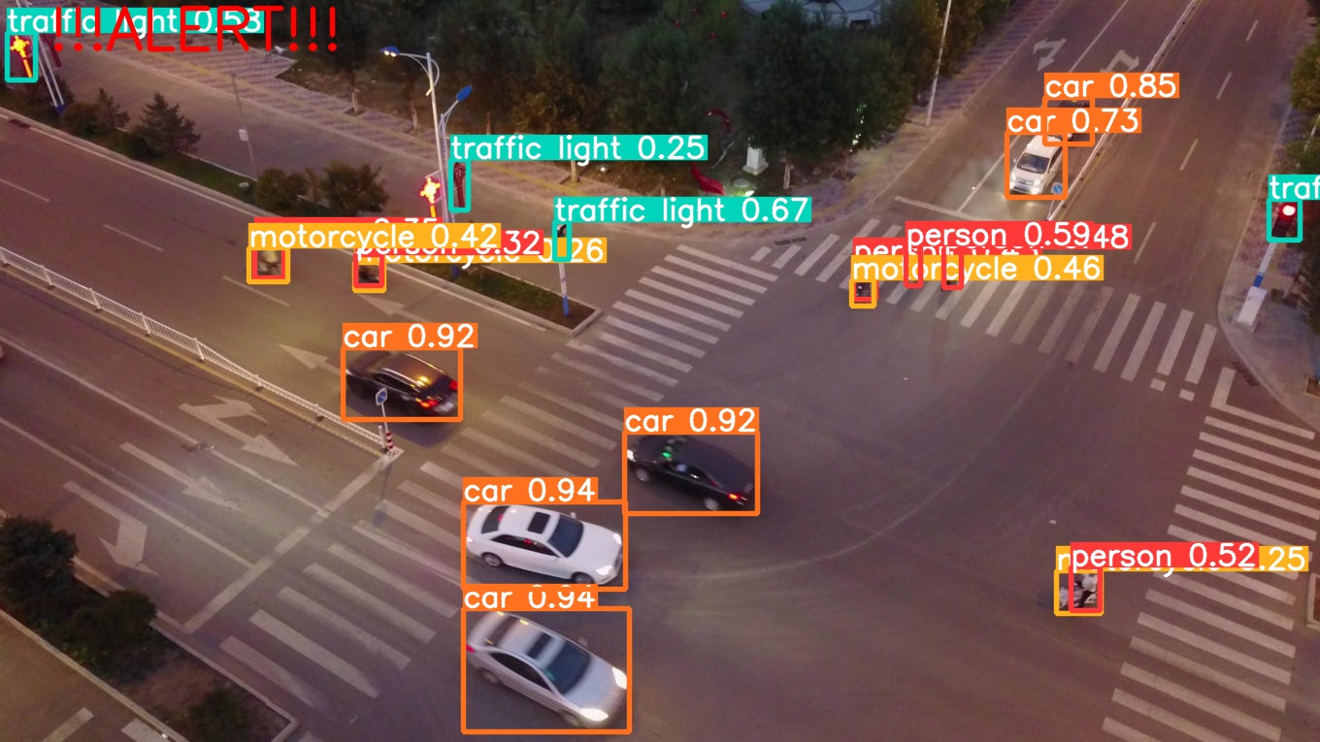
Results and Findings
Testing the model on the VisDrone test dataset (Zhu et al., 2022)

Slide 18
Challenges & Limitations
Low battery life means lower area coverage.
Noisy or inaccurate sensor data.
The YOLOv5 model may face challenges in generalizing to unseen or complex scenarios, requiring continuous fine-tuning and adaptation.
Adverse weather conditions, such as rain, fog, or strong winds, can affect the drone's flight stability and image quality.
The communication link between the drone and the ground control station may experience latency.
Ensuring adherence to aviation regulations, airspace restrictions, and data privacy laws.
Notes:
12,000 mAh capacity and 22.2V battery can achieve 28 minutes of flight time.
28 minutes can cover an area of 1.375 Km2 at 100m/s and 30m altitude. In the simulation

Slide 19
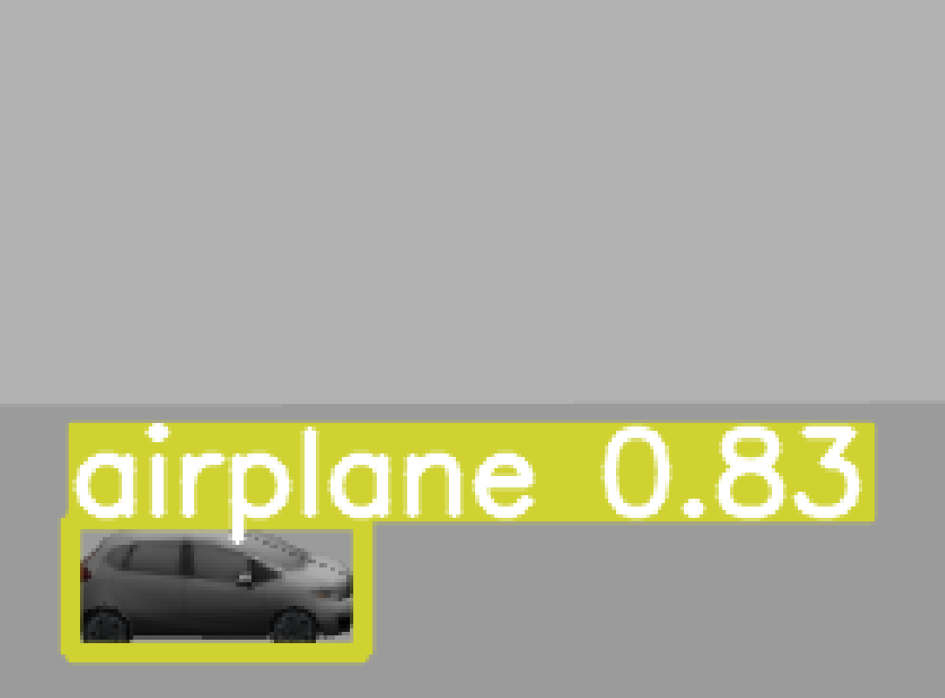
Project Implementation Challenges
Drone license and permit.
Choosing the simulation environment.
Choosing the object detection algorithm.
Object detection algorithm training.
Setting up a workspace.
Notes:
(Linux vs Windows vs MacOS)
Better preforming computer

Slide 20
Conclusion
Evaluated the use of autonomous drones for border security.
Evaluated the use of object detection.
Identified challenges and limitations, such as real-time object detection and legal compliance.
Laid the foundation for future research and practical implementations, contributing to the advancement of autonomous robotics and border security practices.
Highlighted the potential of autonomous drones in revolutionizing border surveillance and security measures.

Slide 21
Future Work and Recommendations
Real testing of the drone in different environments.
GPS to pinpoint the intruder and coordinates for precise deployment of security personnel and real time tracking.
Night vision or IR camera to work in all conditions.
Better cameras to work in higher altitudes.
The use of a private frequency and encrypted network to ensure security of the system.
Enhanced audio/visual alert system such as a siren.
Mobile ground control stations.
Drone fleet to maximize coverage and minimize down time.

Slide 22
Thank you Questions?

